Slide 1
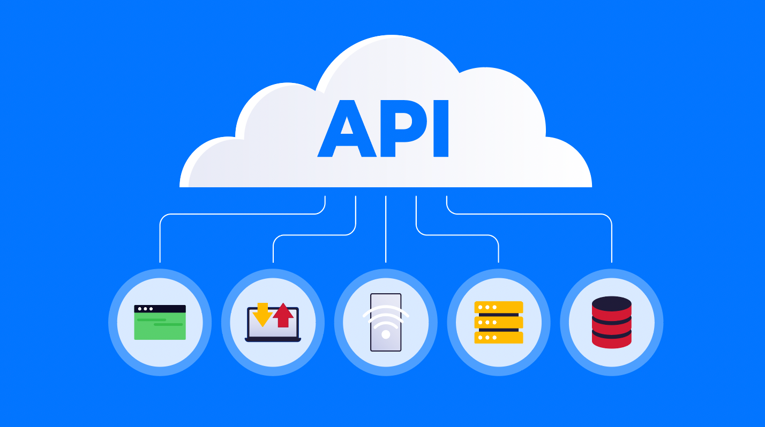
Application Programming Interface

Slide 2
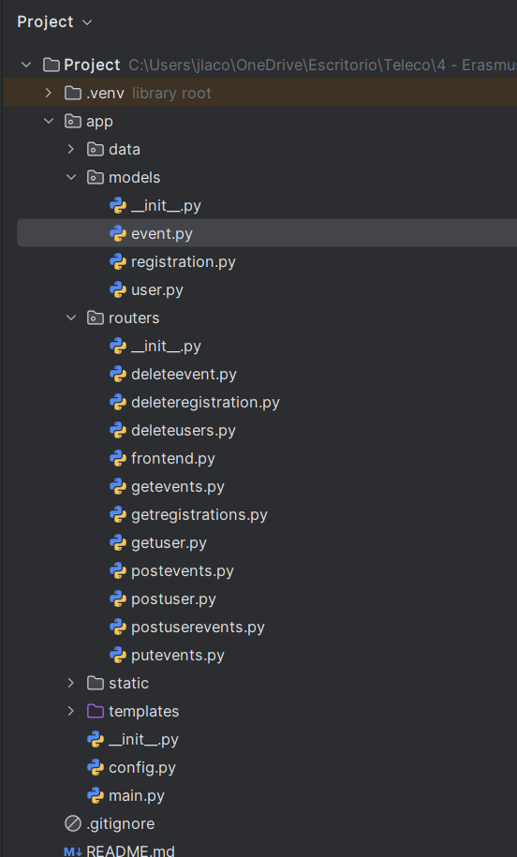
PROJECT APIs
GET /events
POST /events
GET /events/{id}
PUT /events/{id}
GET /users
POST /users
GET /users/{username}
POST /events/{id}/register
GET /registrations
DELETE /registrations/?username={username}&event_id={event_id}
DELETE /users/{username}
DELETE /users
DELETE /events/{id}
DELETE /events

Slide 3
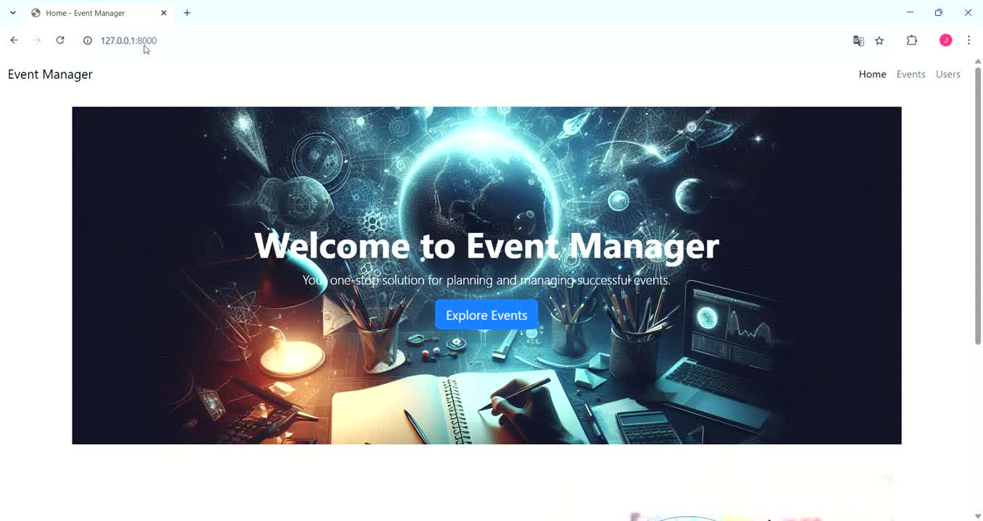
GET /events

Slide 4
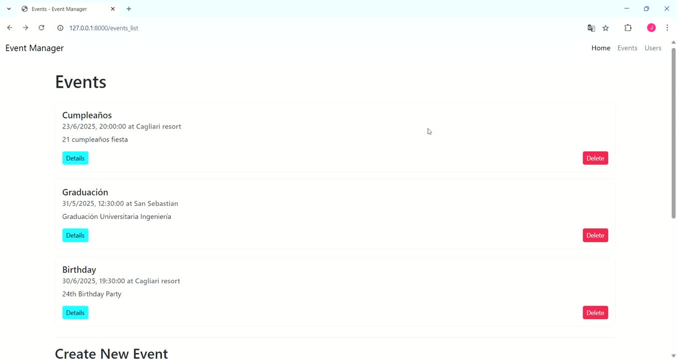
POST /events

Slide 5
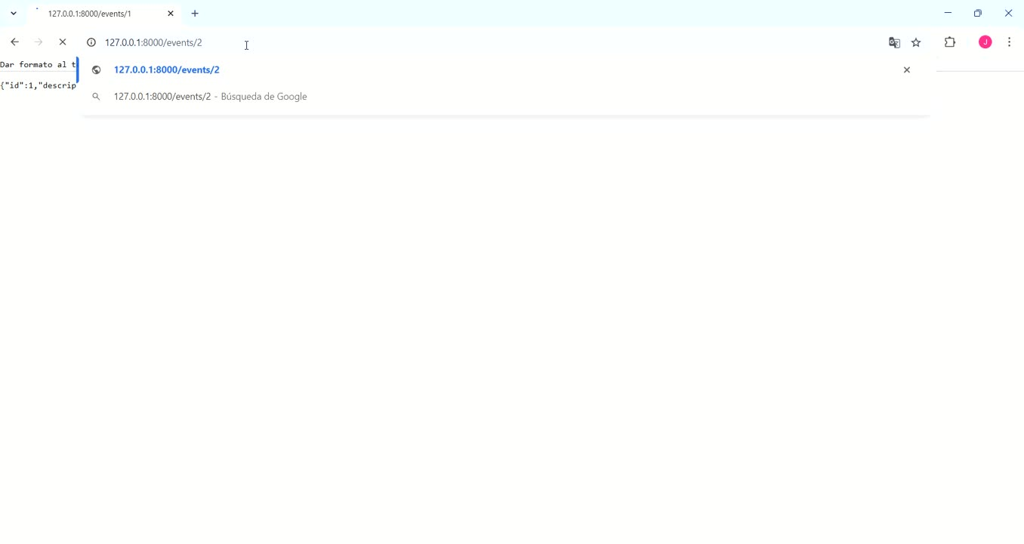
GET /events/{id}

Slide 6
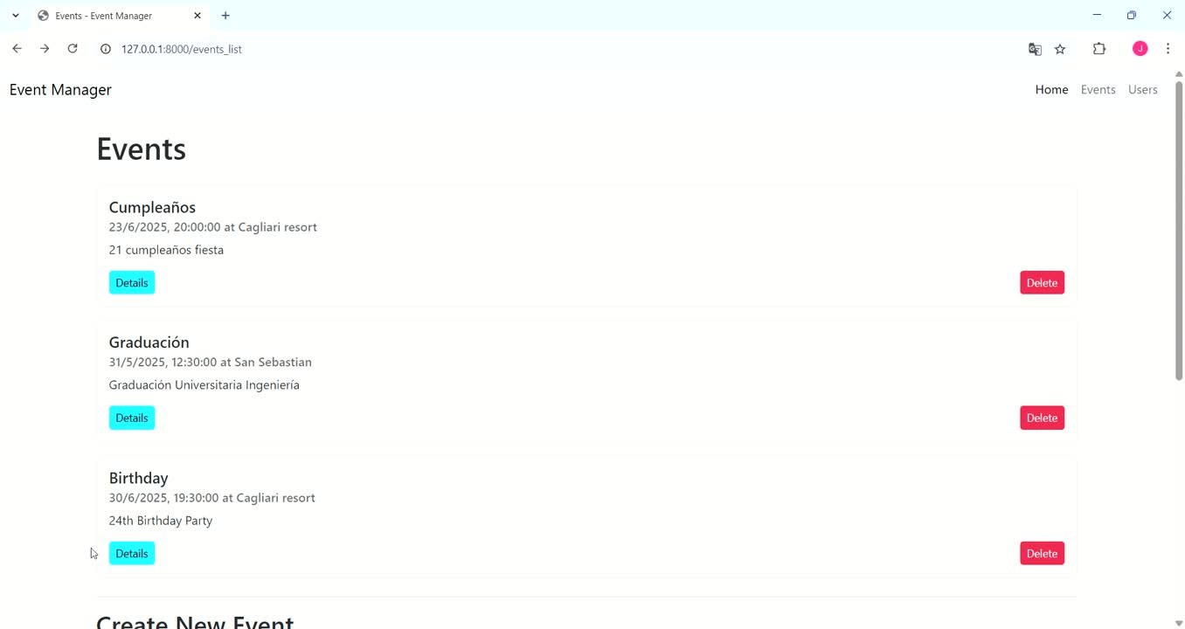
PUT /events/{id}

Slide 7
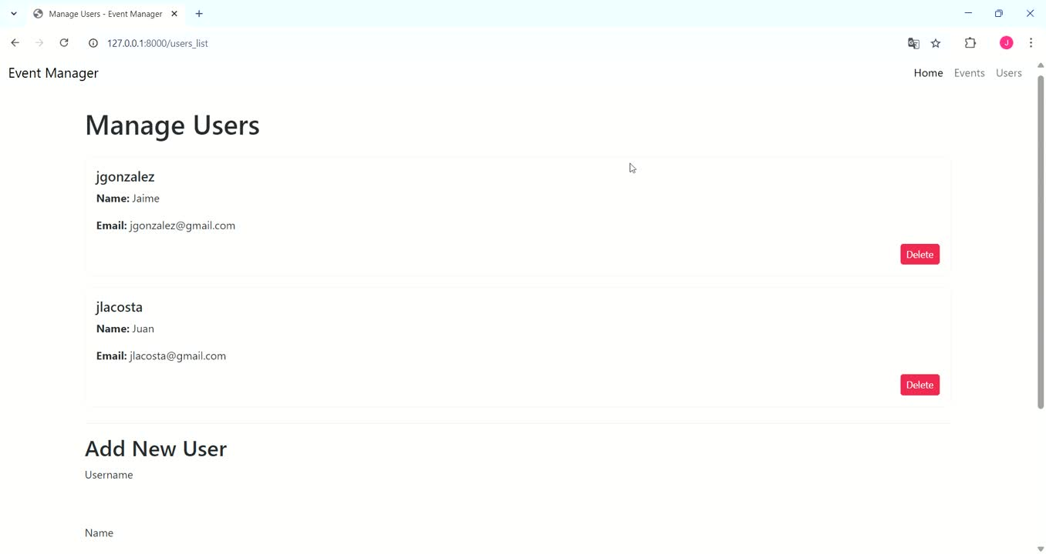
GET /users

Slide 8
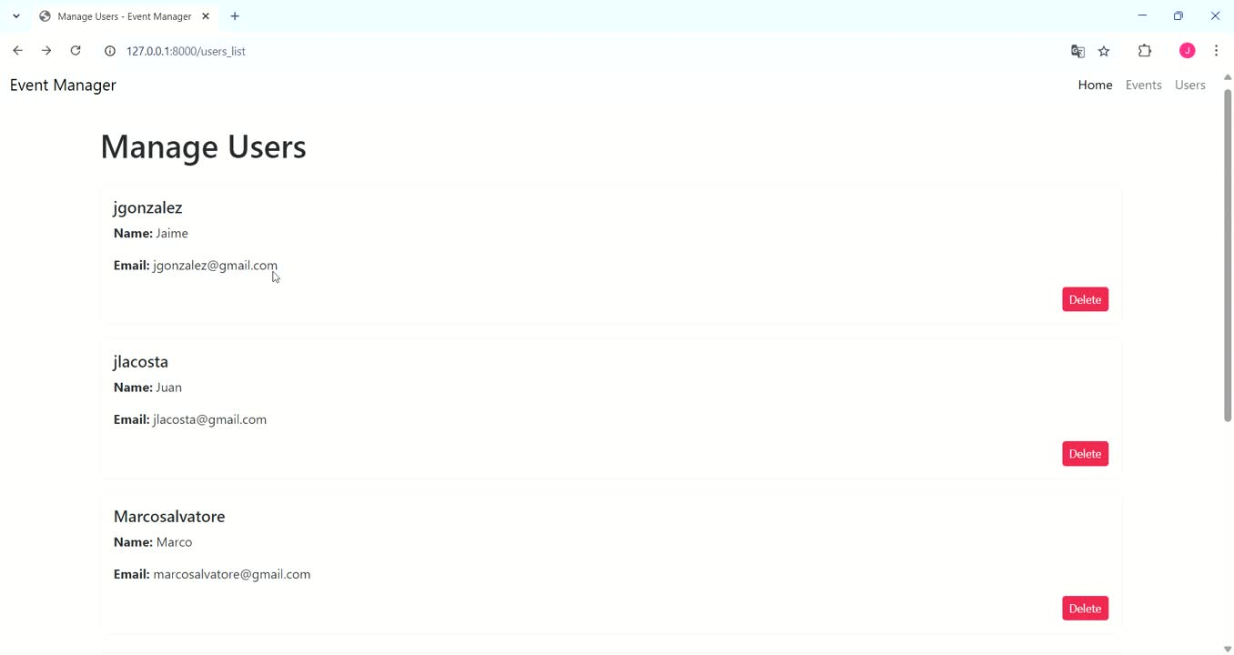
POST /users

Slide 9
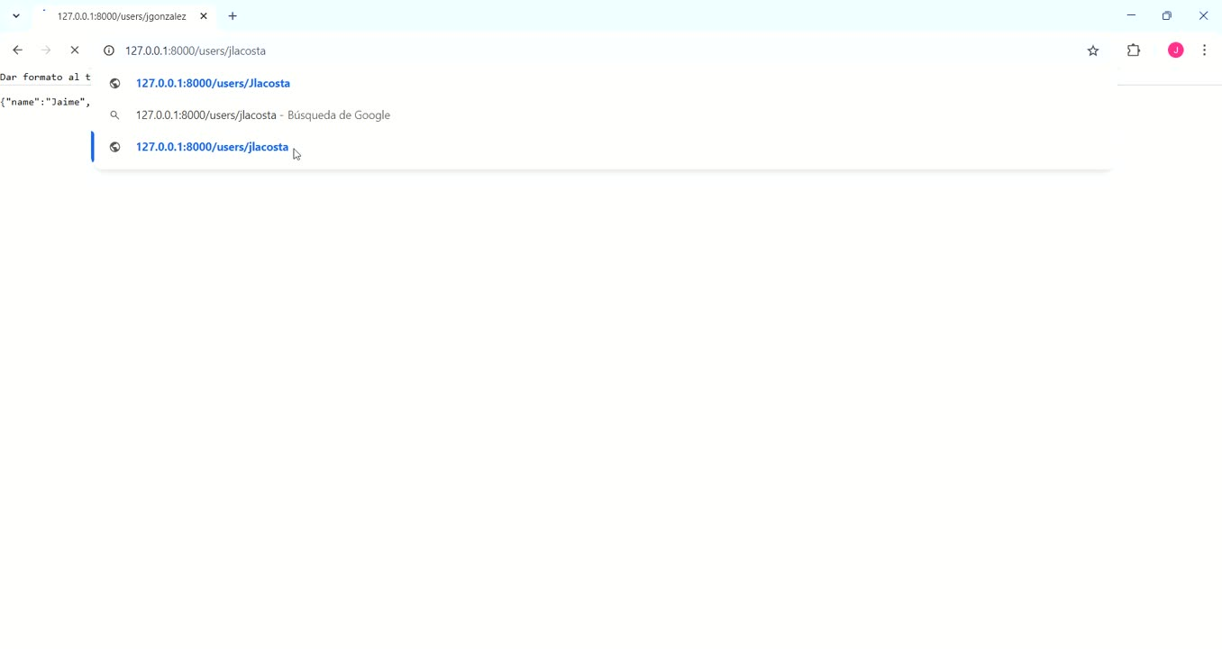
GET /users/{username}

Slide 10
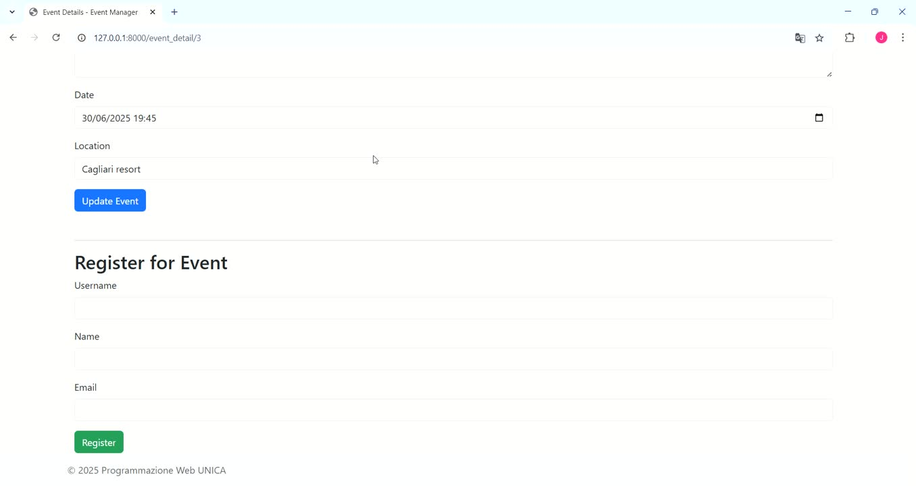
POST /events/{id}/register

Slide 11
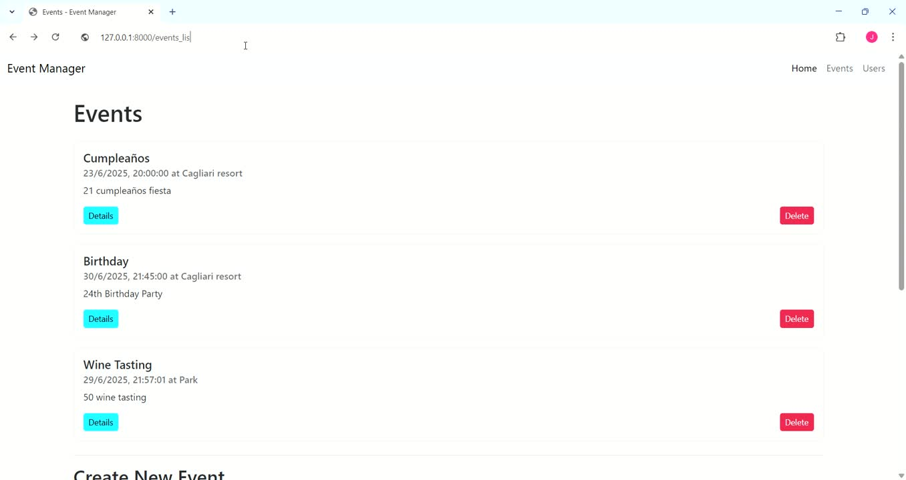
GET /registrations

Slide 12
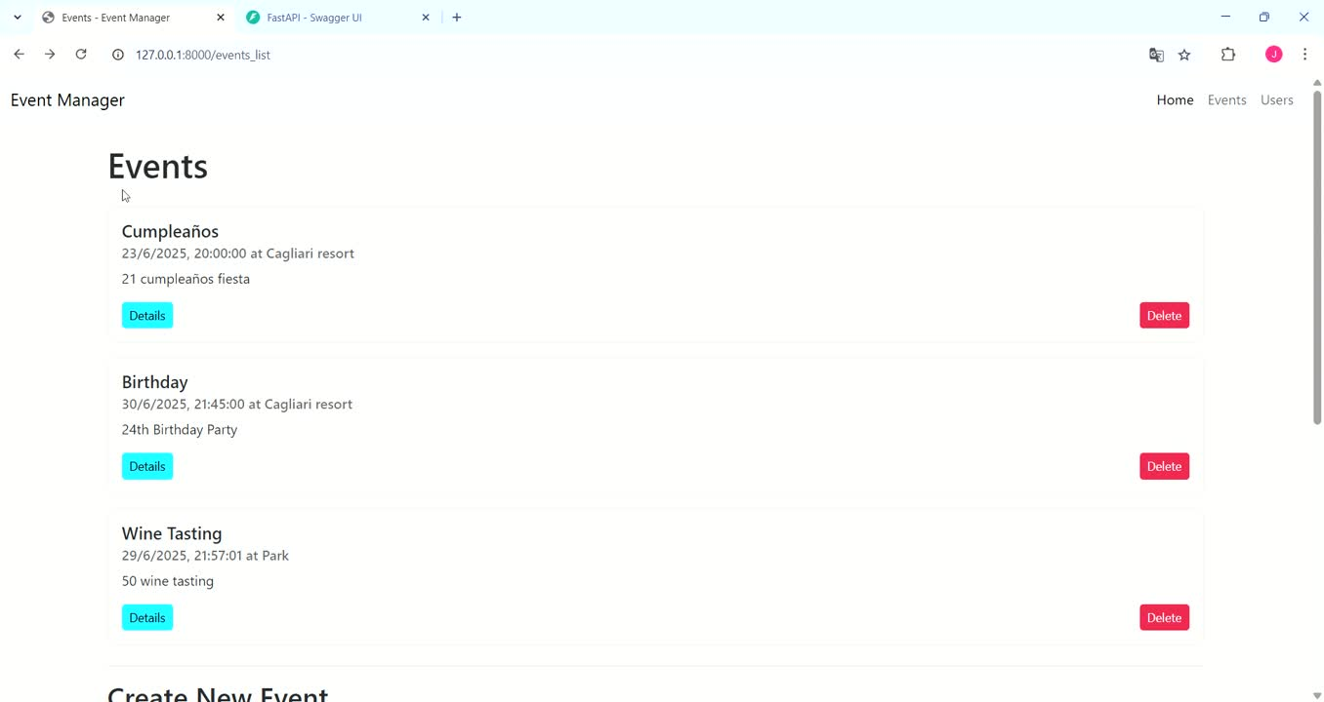
DELETE /registrations/?username={username}&event_id={event_id}

Slide 13
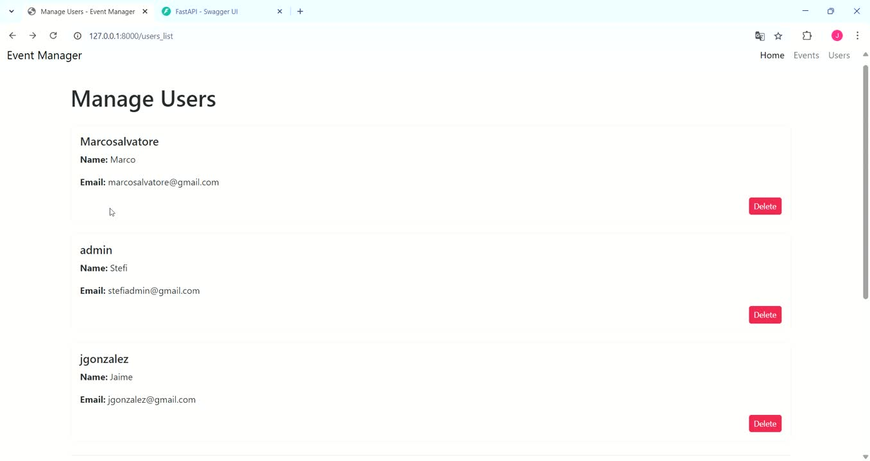
DELETE /users/{username}

Slide 14
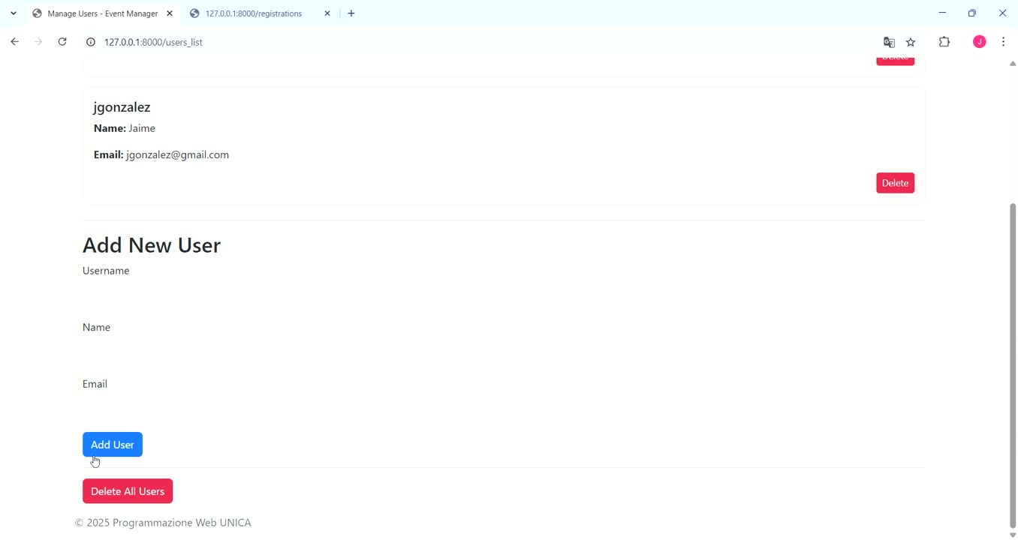
DELETE /users

Slide 15
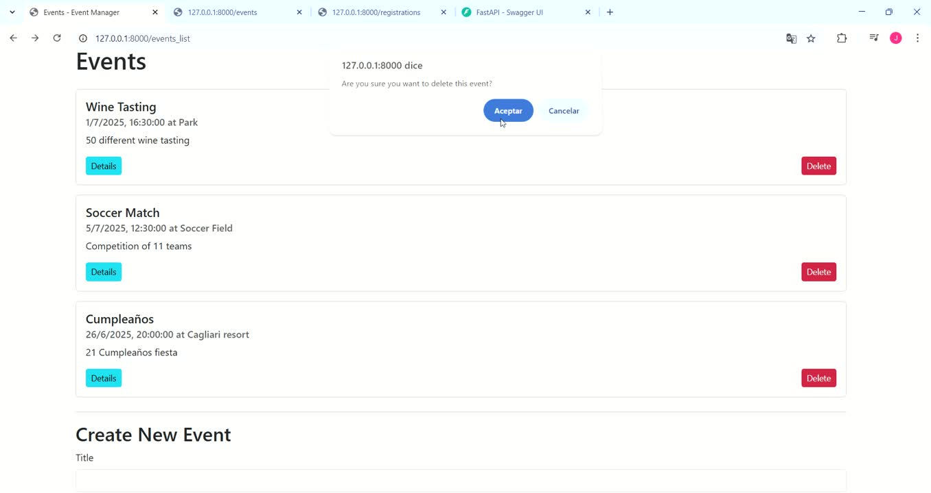
DELETE /events/{id}

Slide 16
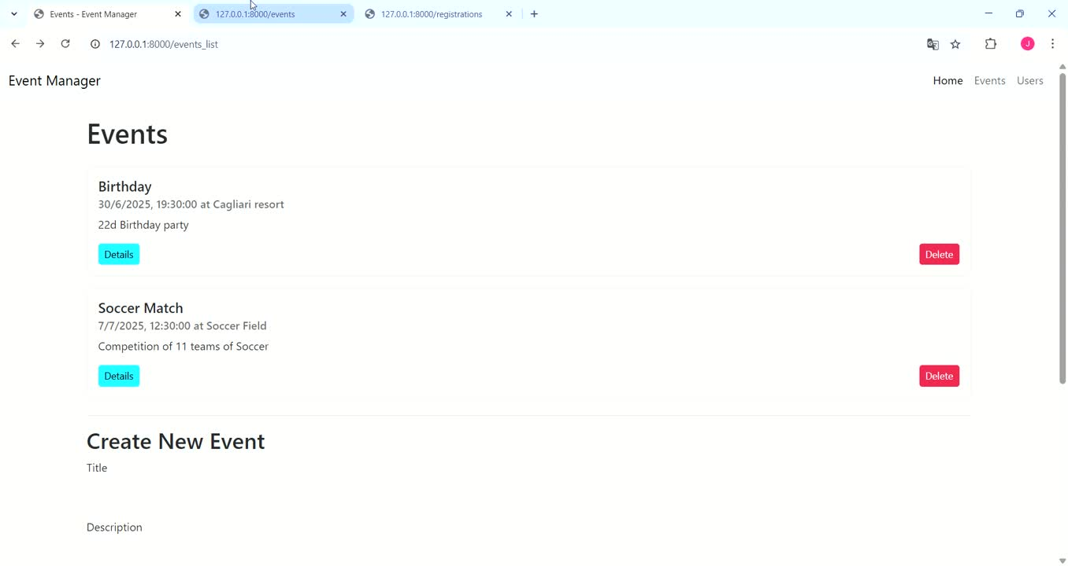
DELETE /events

Slide 17
